Slide 1
Building Trauma Informed Treatment in Clinical Practice: A Curriculum for Addictions and Mental Health Students and Counselors
Nancy H A Burley, Ed.D.
Shannon Dermer, Ph.D.
Cheryl Mejta, Ph.D.

Slide 2
Objectives
Discuss the impact of adverse childhood and adult experiences on behavioral health issues.
Define the meaning of TIC based on disciplinary interpretation
Demonstrate the use of a specialized curriculum across disciplines

Slide 3
Outline
Research on the impact of adverse childhood and adult experiences on health especially mental health and substance use disorders
Traum-informed Treatment Approaches
Online Curriculum of Trauma-Informed

Slide 4

Overall impact of trauma on physical and behavioral health
Notes:
Research has shown that traumatic experiences are associated with both behavioral health and chronic physical health conditions, especially those traumatic events that occur during childhood. Substance use (e.g., smoking, excessive alcohol use, and taking drugs), mental health conditions (e.g., depression, anxiety, or PTSD), and other risky behaviors (e.g., self-injury and risky sexual encounters) have been linked with traumatic experiences. Because these behavioral health concerns can present challenges in relationships, careers, and other aspects of life, it is important to understand the nature and impact of trauma, and to explore healing.

Slide 5
Trauma
In the United States, 61 percent of men and 51 percent of women report exposure to at least one lifetime traumatic event, and 90 percent of clients in public behavioral health care settings have experienced trauma. If trauma goes unaddressed, people with mental illnesses and addictions will have poor physical health outcomes and ignoring trauma can hinder recovery. To ensure the best possible health outcomes, all care — in all health settings — must address trauma in a safe and sensitive way.
https://www.integration.samhsa.gov/clinical-practice/trauma#ACE_Trauma_PTSD_Resources

Slide 6
Trauma
"an event, series of events, or set of circumstances that is experienced by an individual as physically or emotionally harmful or life threatening and that has lasting adverse effects on the individual’s functioning and mental, physical, social, emotional, or spiritual well-being.“
The U.S. Department of Health and Human Services SAMHSA, https://www.hhs.gov

Slide 7
The Importance of Recognizing Trauma
Trauma is a risk factor in nearly all behavioral health and substance use disorders.
Trauma can occur from:
  Childhood abuse or neglect
  Physical, emotional, or sexual abuse
  Accidents and natural disasters
  Witnessing acts of violence
  Grief and loss
  Medical interventions
  Cultural, intergenerational and historical trauma
  Medical interventions

Slide 8
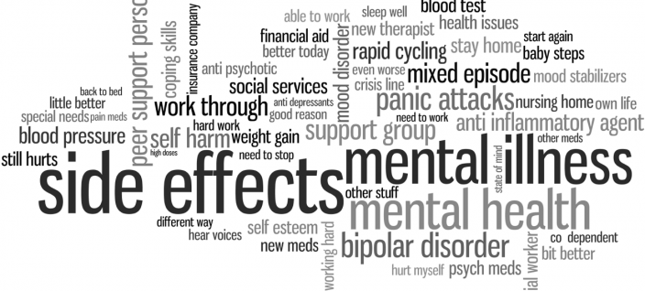
The Effects of Trauma
Bidirectional relationship- mental illness increases the risk of experiencing trauma, and trauma increases the risk of developing psychological symptoms and mental disorders.
Traumatic stress increases the risk for mental illness, (Spitzer, Vogel, Barnow, Freyberger & Grabe, 2007).

Slide 9
Symptoms of Trauma Checklist
Headaches, backaches, stomachaches, etc.
Sudden sweating and/or heart palpitations
Changes in sleep patterns, appetite, interest in sex
Constipation or diarrhea
Easily startled by noises or unexpected touch
More susceptible to colds and illnesses
Increased use of alcohol or drugs and/or overeating
Fear, depression, anxiety
Outbursts of anger or rage
Emotional swings Nightmares and flashbacks — re-experiencing the trauma
Tendency to isolate oneself or feelings of detachment
Difficulty trusting and/or feelings of betrayal
Self-blame, survivor guilt, or shame
Diminished interest in everyday activities
(National Council for Community Behavioral Healthcare)

Slide 10
Trauma-Informed Care
Providing care in a trauma-informed manner promotes positive health outcomes. A trauma-informed approach is defined by SAMHSA as a program, organization, or system that realizes the widespread impact of trauma and understands potential paths for recovery; recognizes the signs and symptoms of trauma in clients, families, staff, and others involved with the system; and responds by fully integrating knowledge about trauma into policies, procedures, and practices, and seeks to actively resist re-traumatization.
https://www.integration.samhsa.gov/clinical-practice/trauma#ACE_Trauma_PTSD_Resources

Slide 11
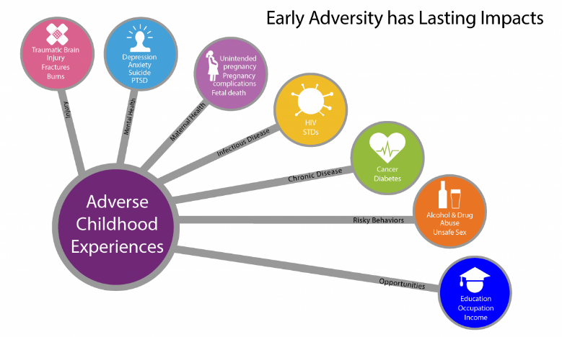
https://www.cdc.gov/violenceprevention/childabuseandneglect/acestudy/ace-graphics.html

Slide 12
Example of Study on ACEs and Opioid Abuse
Examine the relationship between adverse experiences and three landmarks of opioid use: age of opioid initiation, injection drug use, and lifetime overdose.
Interviewed persons seeking inpatient opioid detoxification. Participants were asked about age of opioid initiation, last month injection drug use, and lifetime history of overdose, and completed the ten-item Adverse Childhood Experience (ACE) questionnaire.
the ACE score was inversely associated with age of initiating opioid use (b = −0.50, 95% CI −0.70; −0.29, p < .001), and positively associated with recent injection drug use (OR = 1.11, 95% CI 1.02; 1.20, p = .014) and the likelihood of experiencing an overdose (OR = 1.10, 95% CI 1.02; 1.20, p = .015) in a graded dose response manner.
Greater adverse childhood experiences are associated with three landmarks of opioid use risk. ACE screening may be useful in identifying high-risk subsets of opioid-using populations.
Stein, M. D., Conti, M. T., Kenney, S., Anderson, B. J., Flori, J. N., Risi, M. M., & Bailey, G. L. (2017). Adverse childhood experience effects on opioid use initiation, injection drug use, and overdose among persons with opioid use disorder. Drug and alcohol dependence, 179, 325–329. doi:10.1016/j.drugalcdep.2017.07.007

Slide 13
The Impact of Trauma and substance use disorders
SUD is a common among those exposed to traumatic events, especially those who experienced interpersonal violence
Those with SUD are more likely than most other groups to report a history of trauma exposure and to present with symptoms of PTSD.
3 Major reasons why trauma, PTDS, and SUD may overlap
Trauma survivors seek out psychoactive substances as a way to self medicate posttraumatic distress
Those who heavily use substances are more easily victimized or otherwise prone to trauma exposure
Major substance use leads to more symptomatology in those exposed to trauma

Slide 14
Trauma Syndromes in Non-Western Cultures
Cultures different from North American society may experience/express posttraumatic symptoms differently
“Individuals from non-Anglo-Saxon culture often fail to meet PTSD diagnostic criteria because they lack avoidant/numbing symptoms despite the presence of re-experiencing and arousal symptoms.”

Slide 15
Online Curriculum on Trauma-informed Treatment for Mental Health and Substance Use Counselors
An Interdisciplinary Project bringing Education, Addictions Studies, and Mental Health Counselors together infusing Trauma-informed treatment into the curriculum.

Slide 16

Governors State University
The Addictions Studies graduate program, established in 1984, is accredited by the National Addictions Studies Accreditation Consortium (NASAC) and the Illinois Certification Board (ICB).
The Mental Health Counseling graduate program has been accredited by the Council for Accreditation of Counseling and Related Programs (CACREP) since 1991 and was reaffirmed in 2014 for an additional 8 years

Slide 17

Behavioral Health Education and Training Grant
This resource is supported by the Health Resources and Services Administration (HRSA) of the U.S. Department of Health and Human Services (HHS) as a part of an award totaling, $1,918,092 with 0 percent financed with non-governmental sources. The contents are those of the author(s) and do not necessarily represent the official views of, nor an endorsement, by HRSA, HHS, or the U.S. Government.
For more information, please visit HRSA.gov.

Slide 18
Goals
  Develop and expand the number of addictions counselors and mental health counselors serving populations across the lifespan, with a special emphasis on medically underserved areas in Illinois.
  Develop and/or enhance longitudinal internship sites in behavioral health that include interprofessional experiences in integrated primary and behavioral health care.
  Provide intensive, longitudinal, interprofessional training for students, interns, faculty and field supervisors associated with the addictions program, the counseling program, and other affiliated behavioral health and primary care programs at GSU in an effort to reinforce integrated primary and behavioral health services.
  Make it a priority to recruit and retain underrepresented students.
  Encourage students to return to underserved areas in the Chicagoland area.
  Evaluate the success of the program and make accessible to appropriate audiences through presentations, collaboration with community partners, and establishing an open-access portal in the university’s online repository, OPUS.
  Increasing resources (and access to those resources) that promote Interprofessional collaboration and integrated practice.

Slide 19
Internship
The HRSA, BHWET grant provides 39 students enrolled in the addictions and counseling programs with a $10,000 ($5,000 each semester) stipend to complete their 600 clock hour internships.
Students receive training materials on trauma and integrated behavioral/primary care; monthly seminars/training to enhance competencies in trauma informed care.
$1,500 to attend a national conference

Slide 20
Student Agreement
Complete 2 semesters (600 clock hours) of internship Follow the rules of Addictions or Counseling program
Check email regularly
Provide information for the grant while enrolled and after graduation
Attend at least 2 workshops offered at GSU through the BHWET grant
Attend monthly seminars (hybrid--some are online)
Complete online trauma and integrated care training
Attend a major professional conference (awardee will receive up to $1,500 to attend)
Complete all required paperwork

Slide 21
Online Training Course
Learning Objectives for Course:
Be able to define integrated primary care, underserved areas/populations, trauma, adverse childhood experiences, and resilience.
Know the basic research and literature related to each of the major areas of the course.
Know basic assessment and intervention related to trauma and resilience.
Be able to apply knowledge to prevention and intervention in behavioral health and substance abuse.

Slide 22
BHWET Grant - Overview of the Course Curriculum
Unit 1: Overview of Training
Unit 2: Integrated Health Care
Unit 3: Introduction to Trauma
Unit 4: Adverse Childhood Experiences and Resilience
Unit 5: ACEs and Substance and Abuse
Unit 6: Screening and Assessment of Trauma
Unit 7: Prevention and Treatment of Trauma
Unit 8: Integrated Models of Trauma
Unit 9: Resilience
Unit 10: Trauma and Organizations
Learning Modules with expected outcomes

Slide 23
BHWET Grant
Books for Faculty & Students
Item # | Author | Edition | Title | Publisher | ISBN
1 | Feinstein, R, Connelly, J. Feirnstein, M. | 2017 | Integrating Behvioral Health and Primary Care | Oxford Univ Press | 978-0190276201
2 | King, J.L. | 2016 | Art Therapy, and Neuroscience: Theoretical and Practical Perspectives | Routledge/Taylor Francis | 978-1138839380
3 | Clark, C.Classen, C.C; Fourt, A., Shetty M. | 2014 | Treating the Trauma Survivor: An Essential Guide to Trauma - Informed Care | Routledge/Taylor Francis | 978-0415810982
4 | Steele, W., Malchiodi, C. A. | 2011 | Trauma-Informed Practices with Children and Adolescents | Routledge/Taylor Francis | 978-0415890526
5 | Evans, A., Coccoma, P. | 2017 | Trauma-Informed Care: How Neuroscience Influences Practice (Explorations in Mental Health) | Routledge/Taylor Francis | 978-1138637160
6 | Lanktree, C.B.; Briere, J.N. | 2016 | Treating Complex Trauma in Children and Their Families: An Integrative Approach | SAGE Publications | 978-1452282640
7 | Briere, J.N.; Scott, C. | 2014 | Principles of Trauma Therapy: A Guide to Symptoms, Evaluation, and Treatment (DSM-5 Update) | SAGE Publications | 978-1483351247
8 | Briggs, R.D. | 2016 | Integrated Early Childhood Behvioral Health in Primary Care: A Guide to Implementation and Evaluation | Springer Nature .com | 978-3319318134
9 | Curran, L. | 2013 | 101 Trauma-Informed Interventions: Activities, Ecercises, and Assignements to Move the Client and Therapy Forward | PESI, Inc | 978-1936128426
10 | NAADAC.org | 175 pg manual | Addiction Professional's Guide to Screening, Brief Intervention & Referral to Treatment Manual | NAADAC.org | reg vs member cost

Slide 24
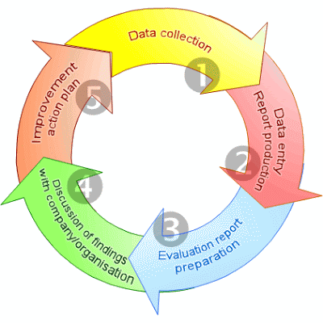
BHWET Grant
Evaluation of the curriculum

Slide 25

Implications for Education and Treatment
Enhancement of mental health and substance use counselors’ competencies
Improved treatment outcomes for mental health and substance use disorders
Prevention of mental health and substance misuse

Slide 26
Where do we go from here?

Slide 27
Governors State University Contact Information
Nancy H. A. Burley, Ed.D nburley@govst.edu
Shannon B. Dermer, Ph.D. sdermer@govst.edu
Cheryl Mejta, Ph.D. cmejta@govst.edu

